Slide 1
The change in Business Risk in Banking: Implications for Nordea
A Scenario Analysis for the Board of Directors
By Halvard Bø, Even Riber Haugland, Emil Zachariassen Hurv, Brede Espelid and Markus Langfeldt Nicolaisen
Notes:
Nordea’s risk concerns in a technological future
Exemplified by our theoretical scenario of Apple introducing a financial service. Namly payments, investments, loans and banking.
The main points are about a liquidity concern, reduced deposits at Nordea due to competition. Our presentation shines a light on the need to consider strategic risks as well as traditional risk management. (evt. As well as….)
(stemmer dette?)
Risk elements;
Market share, And in extension liquidity risk
Credit risk

Slide 2



Introduction to Business Risk
• BUSINESS RISKS TURNED STRATEGIC
• SHIFT FROM TRADITIONAL BANKING RISKS TO CONSUMER SHIFT RISKS
• IMPORTANCE OF ADDRESSING THESE RISKS FOR NORDEA'S FUTURE
Notes:
Although we’re familiar with the traditional views on risk management through for example managing the Capital Adequacy Ratio (CAR), it's also important to look at the competitive and strategic risks that a bank like Nordea faces.
We will look at the potential consequences of the introduction of larger FinTech competitors, and its implication on risk management, and finally how Nordea might need to handle this development.
As the article from Barrie Wilkinson states; The risk focus might need to shift from the chief risk officer and the risk function, to the chief executive officer and the CFO, COO and CEO ect.
The next bank failure we experience is just as likely to result from a loss of customer business as from a surge in bad debt or another financial shock.
Traditional banking may be put to the test in the face of new competition. They may need to shift their operations to better accommodate customer preferences, ensuring they have a future.

Slide 3
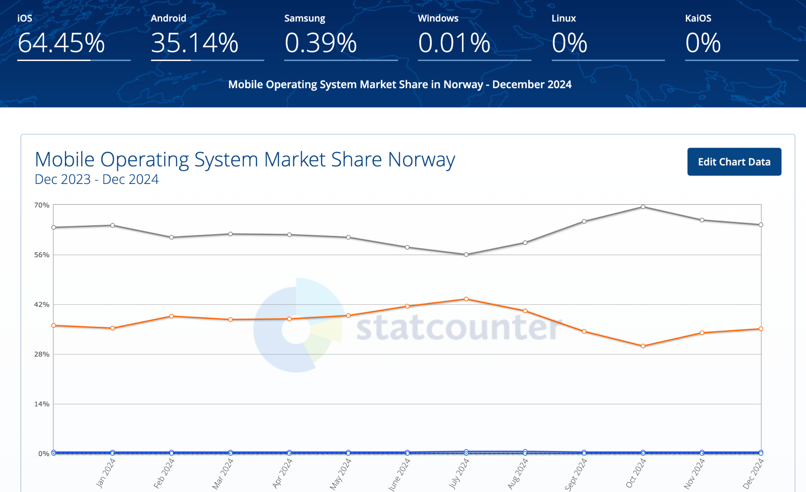
Scenario: Apple's Financial Super App
• Hypothetical scenario: Apple launches a comprehensive financial services app
• Features: Payments, investments, loans, and banking services
• Leverages Apple's brand, user base, and technology
Notes:
Apple's Strategic Move:
Apple's entry into financial services aligns with its diversification strategy and emphasis on ecosystem integration.
Leveraging its existing user base of over a billion devices worldwide.
Comprehensive Offerings:
Payments (Apple Pay integration).
Investments (easy-to-use investment platforms).
Banking (digital-first approach with seamless integration into the Apple ecosystem).
Competitive Advantage:
Trust in Apple's brand for security and innovation.
Synergy between hardware (iPhones, Apple Watches) and financial services.
Superior user experience with Apple's design philosophy.
Impact on Banking Sector:
Disruption of traditional banking models by offering a tech-first approach.
Potential to capture tech-savvy demographics, particularly in the Nordics.
Market Opportunity in the Nordics:
High smartphone penetration and digital payment adoption.
Nordic consumers' preference for seamless, tech-driven financial solutions.
Potential Challenges:
Regulatory hurdles in financial services.
Competition from established banks and fintech players.
Balancing data privacy concerns with personalized offerings.
Norwegian customer service, and local laws
Conclusion:
Apple's foray into financial services could redefine consumer expectations and push the industry toward more tech-driven innovation.
"Let's consider a hypothetical scenario where Apple launches a comprehensive financial services app. This app would offer payments, investments, loans, and banking services, leveraging Apple's strong brand, vast user base, and technological expertise. Such a move could significantly disrupt the banking sector, particularly in tech-savvy markets like the Nordics."

Slide 4
Threat to Nordea's Business Model
• Potential loss of market share in Nordic countries
75% of Millennials would switch financial institutions for a better mobile banking experience. They expect clean, easy-to-navigate interfaces requiring minimal effort to accomplish tasks, quick transactions and interactions, minimal loading times, and consistency across devices.
ADVANTAGE. (2024, June 4). Technology trends to attract younger generations. JMFA. https://advantage-fi.com/technology_trends_attract_new_generations/
• Erosion of customer base, especially younger demographics
• Challenge to Nordea's digital banking initiatives
Notes:
Threat to Nordea's Market Share:
Apple’s entry into financial services could attract younger, tech-savvy customers who prioritize convenience and innovation.
High adoption rates of Apple products in the Nordics increase the risk of customer migration.
Impact on Digital Banking Initiatives:
Apple's seamless integration of financial services with its ecosystem could outpace Nordea's digital offerings.
Risk of Nordea's digital efforts being perceived as less innovative or user-friendly in comparison.
Competitive Pressure:
Increased competition in key segments like mobile payments, personal loans, and investments.
Apple's branding and trustworthiness could overshadow Nordea’s market positioning.
Customer Retention Challenges:
Younger demographics are drawn to the simplicity and interconnectivity of tech-driven solutions.
Nordea may need to enhance customer engagement to retain these groups.
Strategic Response Needed:
Accelerate innovation in digital banking to match or exceed new market standards.
Explore partnerships or integration with tech platforms to remain competitive.
Regulatory Considerations:
Apple’s entry might influence financial regulators, prompting new rules that could also impact Nordea’s operations.
Conclusion:
While this poses significant challenges, it is also an opportunity to reassess Nordea's value proposition and strengthen its digital transformation strategy.

Slide 5

Impact on Nordea's Efficiency Ratios
• Potential increase in cost-to-income ratio
• Comparison: Nordea's current ratio vs. Apple's projected ratio
• Need for significant cost-cutting or revenue growth to remain competitive
Notes:
What are the impacts on Nordeas Efficiency ratios?
Nordea might experience an increase in cost-to-income ratio
In order to compete with Apple’s tech-driven offerings, Nordea might need to increase investments in digital infrastructure, like new online banking platforms in order to make their financial services more convenient.
Also, Nordea might feel pressure to increase marketing efforts to retain existing customers, which could drive costs higher.
Comparing Nordea’s current ratio vs. Apple’s projected ratio
Nordea is likely to operate with a higher cost-to-income ratio than Apple, where traditional banks usual face a ratio of 50-60 percent, while fintech companies have a ratio of 10-20 percent. This is due to fintech companies operating with a leaner cost structure due to its tech-first model and extensive use of automation and AI.
However, Apple entering the fintech market would drive additional scale up costs, possibly aligning Nordea’s current ratio to Apple’s projected ratio to some degree.
Lastly, in order to remain competitive, there will be a need for Nordea to either cut costs significantly or increase revenue

Slide 6

Effect on Credit Risk
• Potential loss of prime customers to Apple's offering
• Increase in non-performing loans ratio
• Impact on Nordea's credit risk models and provisioning
Notes:
As Marcus earlier mentioned, Nordea will probably face credit risk due to Apple entering financial services:
The first one is the potential loss of prime customers to Apple’s offerings
Prime customers are customers that shows high ability and willingness to repay their debt. And their fluctuations to Apple’s services could leave Nordea with a less favorable customer base, skewing its portfolio towards higher-risk borrowers.
As a result, it can lead to an increased non-performing loans ratio
Because, as prime customers migrate to Apple, Nordea might retain more subprime og marginally creditworthy customers, which increases the risk of defaults, affecting the non-performing loans ratio.
This change in borrower profiles may force Nordea to update their credit risk models through recalibration to account for a more risky portfolio of borrowers.
In addition, with a more risky credit mix, Nordea might need to increase provisions, where future expected losses are considered.

Slide 7
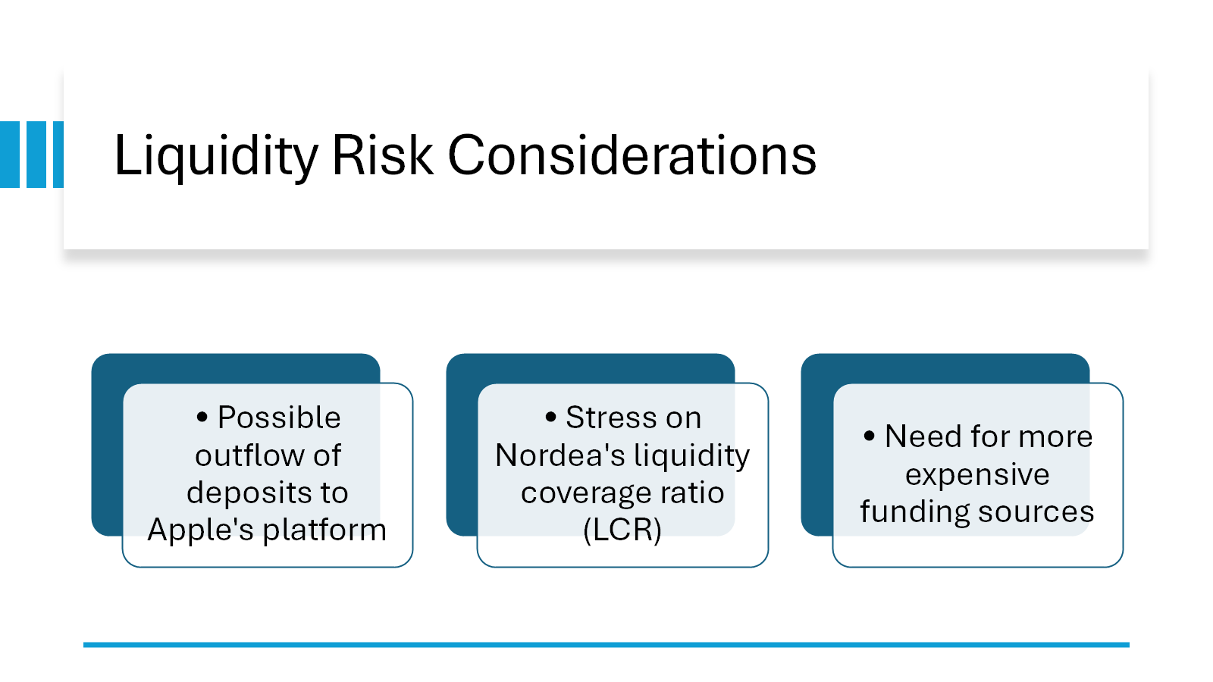

Slide 8
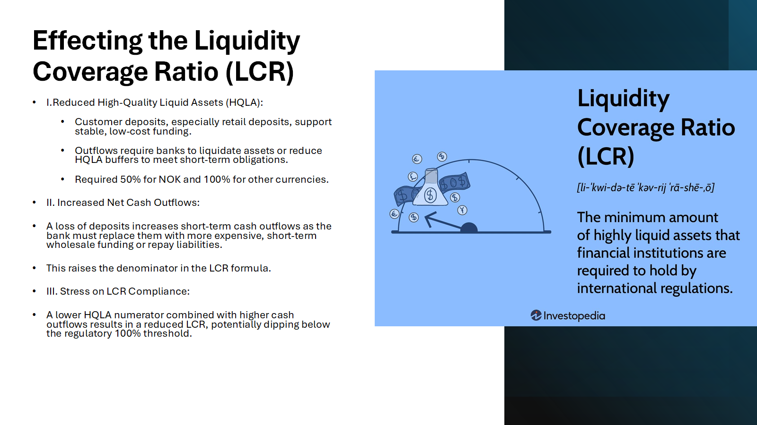
Liquidity Risk Considerations
• Possible outflow of deposits to Apple's platform
• Stress on Nordea's liquidity coverage ratio (LCR)
• Need for more expensive funding sources
Notes:
"On the liquidity front, we could face a possible outflow of deposits to Apple's platform. This would put stress on our liquidity coverage ratio (LCR) and might necessitate turning to more expensive funding sources to maintain our liquidity position."

Slide 9
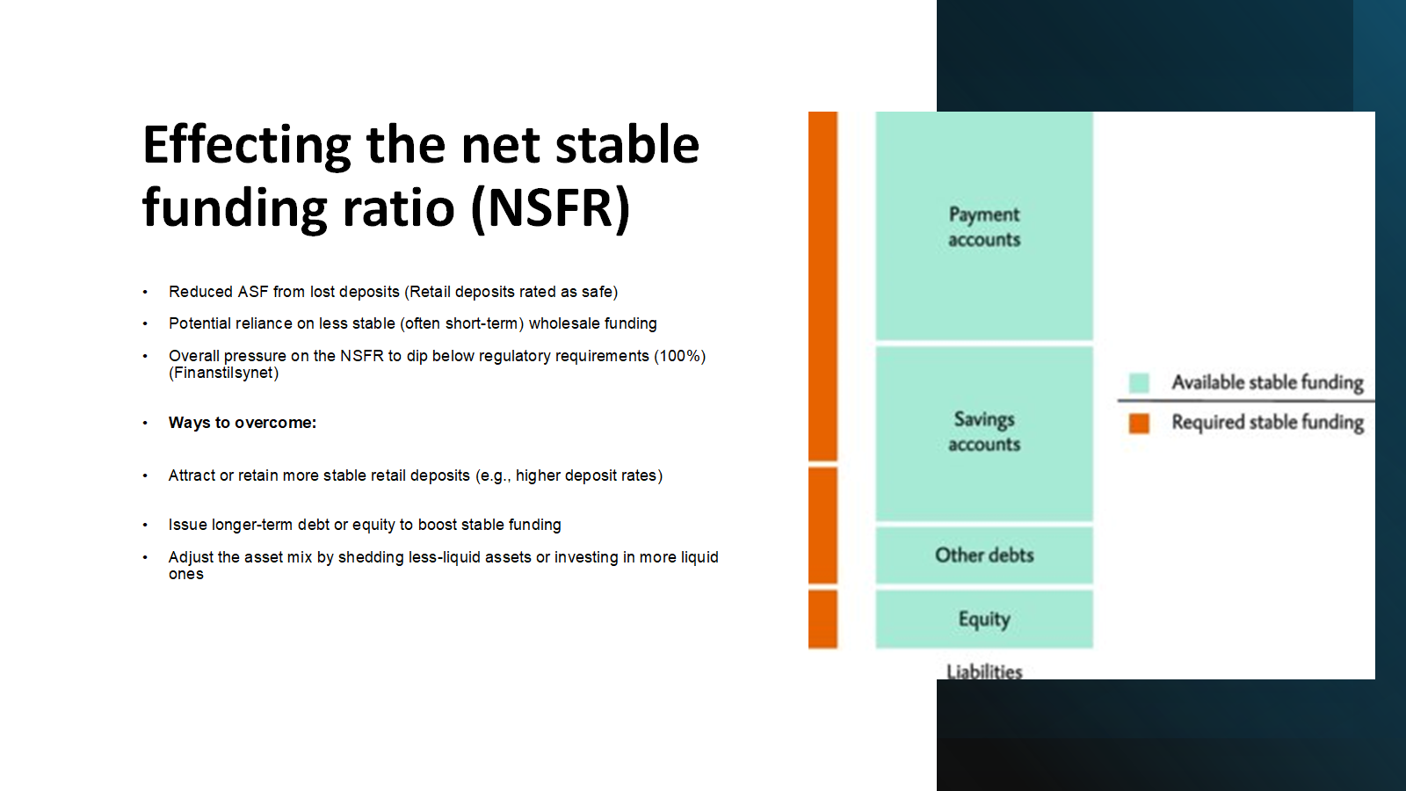

Effecting the net stable funding ratio (NSFR)
Reduced ASF from lost deposits
Potential reliance on less stable (often short-term) wholesale funding
Overall pressure on the NSFR to dip below regulatory requirements
Ways to overcome:
Attract or retain more stable retail deposits (e.g., higher deposit rates or promotions)
Issue longer-term debt or equity to boost stable funding
Adjust the asset mix by shedding less-liquid assets or investing in more liquid ones
Improve contingency funding plans to handle sudden drops in deposits

Slide 10
Regulatory Capital Implications
• Potential decrease in return on equity
• Pressure on capital adequacy ratios
• Need for balance sheet optimization and capital raising
Notes:
"From a regulatory capital perspective, we could see a potential decrease in ROE and increased pressure on capital adequacy ratios. To address this, we might need to optimize the balance sheet and consider raising additional capital."

Slide 11
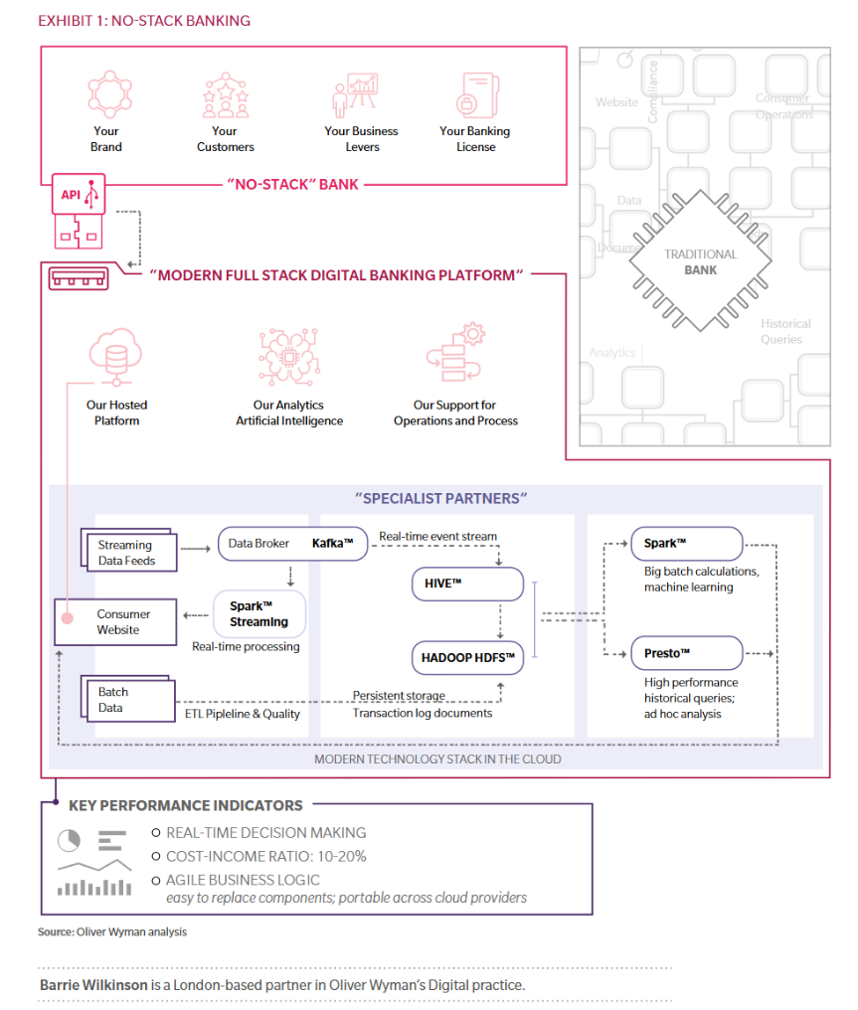
Strategic Responses
• Invest in advanced data analytics and AI for better services
• Explore potential partnerships with fintech companies
• Consider a "no-stack” banking model ?
Notes:
To counter these risks, we propose several responses. First, we should invest in advanced data analytics and AI to offer more personalized services. Second, we could explore partnerships with fintech companies to enhance our technological capabilities. Lastly, we might consider adopting a 'no-stack banking' model to reduce costs and increase our agility.

